Slide 1


BORROW
BOX
COURSE: SOFTWARE ENGINEERING (CS3009)
SEMESTER: SPRING 2025
SUBMISSION DATE: APRIL 28, 2025

Slide 2





OUR TEAM
FAZAL ZAMAN (22I-2362)
HEER
(22I-2371)
M.FAWAZ
(22I-2340)
02

Slide 3


nall geeks
ABOUT PROJECT
Purpose:
To create a digital platform for peer-to-peer product rentals.
Goals:
Enable users to rent products directly from each other
Provide user-friendly product listing, approval, and review mechanisms
Ensure admin control, dispute resolution, and detailed analytics
03

Slide 4
FUNCTIONAL AND NON-FUNCTIONAL REQUIREMENTS
Functional Requirements
Non-Functional Requirements
User Authentication & Profile Management
Product Listing and Management
Rental Request & Approval Flow
Report Generation & Analytics
Review System with Ratings
Search & Filtering Tools
Admin Dashboard & Dispute Resolution
Fast performance: Load pages in < 2 seconds
High availability: 99.9% uptime
Secure: SSL/TLS encryption
Scalable and modular architecture
GDPR compliance
Multi-language support
Cross-browser compatibility
04

Slide 5


USER STORIES
:User
Register, browse products, request rentals, view history, give feedback
Owner:
List/manage products
Admin:
Manage users, resolve issues, generate reports
05

Slide 6

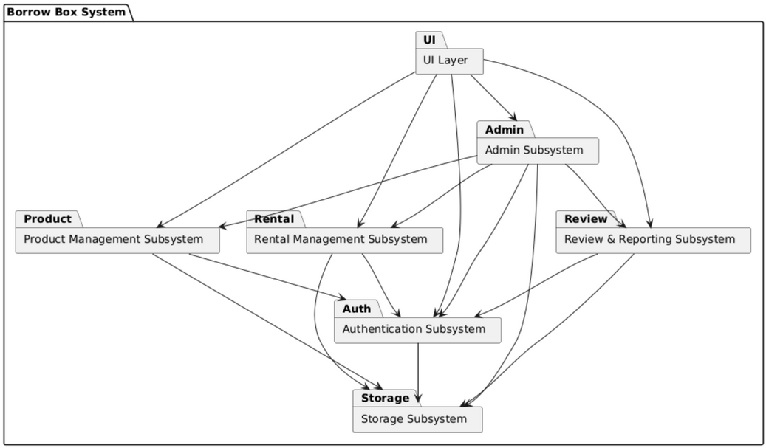
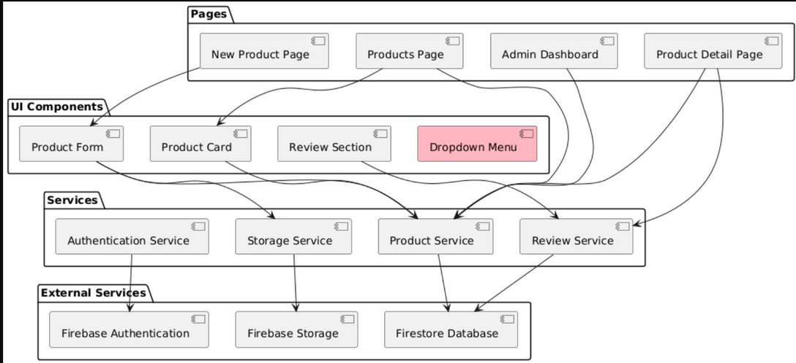
SYSTEM ARCHITECTURE
Architecture Style: Client-Server Architecture
Frontend: React (NEXT.js)
Backend: Layered APIs (AuthService, ProductService, RentalService)
Database: Relational DB (MYSQL)
Included Diagrams:
Package Diagram: Divides core modules (Auth, Rental, Feedback, Admin)
Component Diagram: Services interacting via REST APIs
Deployment Diagram: Cloud-hosted frontend/backend with DB access
06

Slide 7


TESTING
Black Box Testing: Validations, input-based tests
White Box Testing: Unit tests, coverage analysis
Final QA with bug fixes and UX polish
07

Slide 8
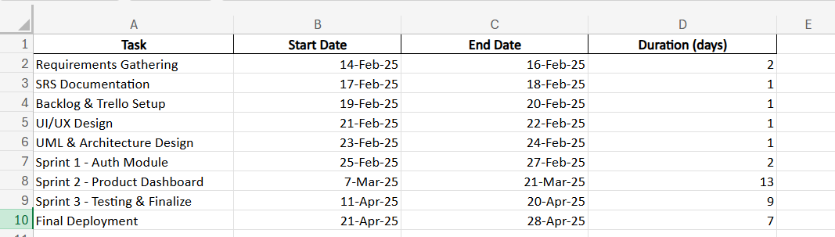
PROJECT PLANNER
Work Breakdown Structure:
Requirements, Design, Development, Testing, Deployment
Sprint Planning:
Sprint 1: Auth, Session Handling
Sprint 2: Product & Dashboard Modules
Sprint 3: Admin, Testing, Reporting
08

Slide 9
DESIGN & SPRINT
3 FEATURES
Admin Controls with RBAC
Manage Products and Users
Report Generation Module
Testing(WHITE BOX/BLACK BOX)
UX Enhancements and Final Deployment
09

Slide 10
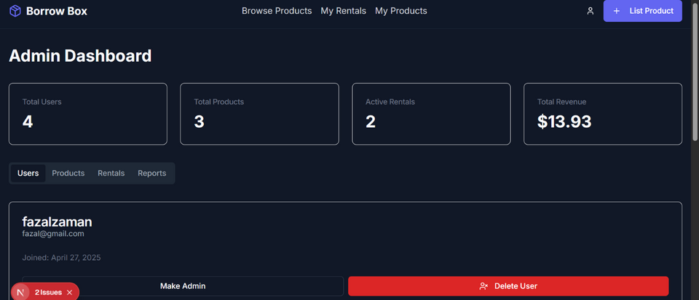
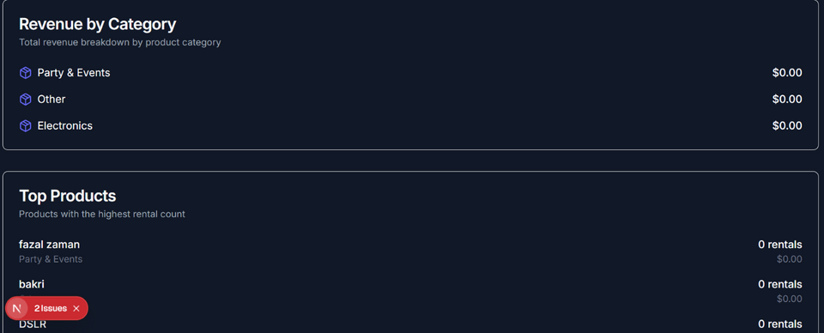
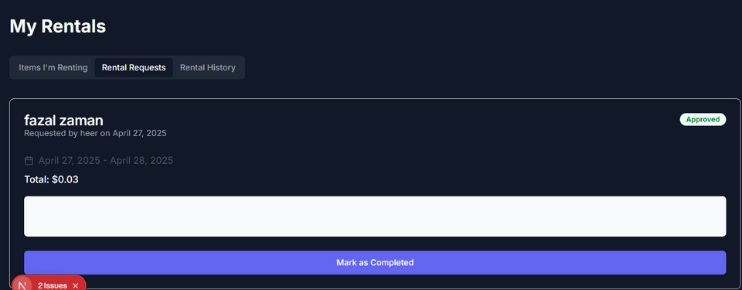
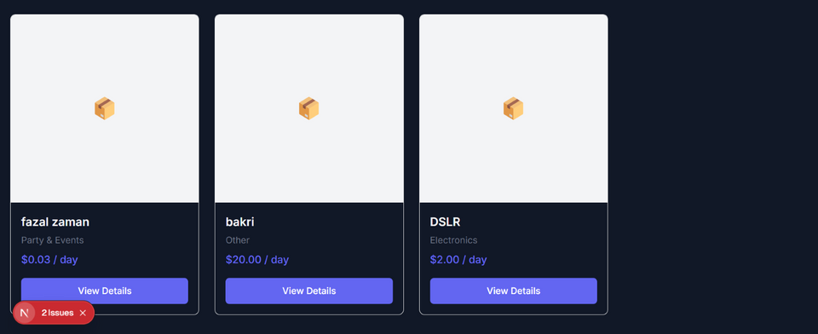
IMPLEMENTATION & SCREENSHOTS
10

Slide 11



FURTHER IMPROVEMENTS
Mobile App Integration
AI-based product recommendations
Real-time chat between renter and owner
Payment gateway integration
Push notifications for approvals and reminders
11

Slide 12
nall geeks
CONCLUSION
Lessons Learned:
Agile planning, collaborative teamwork
Modular backend design and frontend integration
Handling real-world use cases in testing
Team Reflections:
Stronger understanding of system development lifecycle
Improved communication and version control usage
12

Slide 13

THANK YOU!
10

